Slide 1
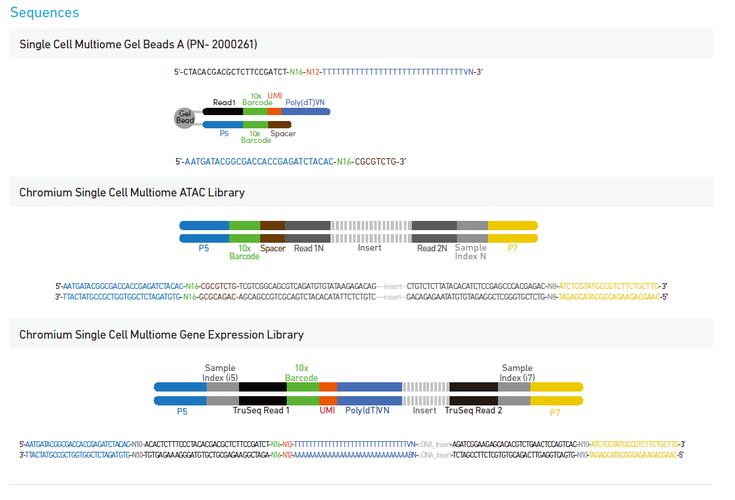
R1 sequence 150
R2 8+16
R3 sequence 150
R2 如果只有16bp，一般已经反向互补过
R1 barcode forward 16+8
R2 sequence 90

